Slide 1











$f(x_{1},x_{2}$, $x_{3}$, $x_{4})=\overline{x_{2}} \overline{x_{4}} ∨\overline{x_{2}} x_{3}∨ \overline{x_{1}} x_{3} \overline{x_{4}}∨x_{1} \overline{x_{3}} \overline{x_{4}} ∨ \overline{x_{1}} x_{2}\overline{x_{3}} x_{4}$
$x_{1} x_{2}$ $x_{3}$ $x_{4}$
&
$$x_{1}⋅\overline{x_{3}}⋅\overline{x_{4}}$$
&
$$\overline{x_{1}} x_{3} \overline{x_{4}}$$
1
$$f$$
&
$$\overline{x_{2}}⋅x_{3}$$
$$\overline{x_{1}}$$
$$\overline{x_{2}}$$
&
$$\overline{x_{1}} x_{2}\overline{x_{3}} x_{4}$$
$$\overline{x_{3}}$$
$$\overline{x_{4}}$$
&
$$\overline{x_{2}} \overline{x_{4}}$$

Slide 2
$f(x_{1},x_{2}$, $x_{3}$, $x_{4})=x_{1}⋅\overline{x_{3}}⋅\overline{x_{4}}∨\overline{x_{1}}⋅\overline{x_{2}}⋅\overline{x_{3}}⋅\overline{x_{4}}∨\overline{x_{1}}⋅\overline{x_{3}}∨\overline{x_{2}}⋅x_{3}∨\overline{x_{1}}⋅\overline{x_{4}}$

Slide 3
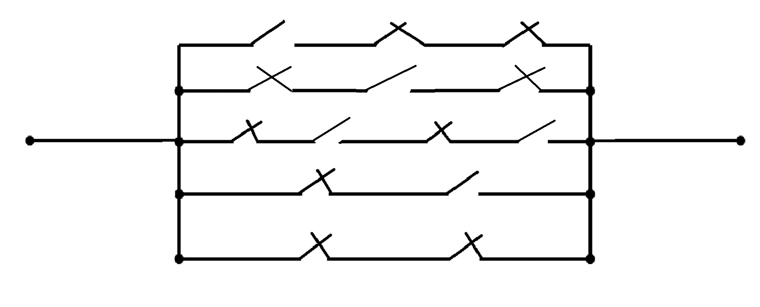



























$f(x_{1},x_{2}$, $x_{3}$, $x_{4})=\overline{x_{2}} \overline{x_{4}} ∨\overline{x_{2}} x_{3}∨ \overline{x_{1}} x_{3} \overline{x_{4}}∨x_{1} \overline{x_{3}} \overline{x_{4}} ∨ \overline{x_{1}} x_{2}\overline{x_{3}} x_{4}$
$$x_{1}$$
$$\overline{x_{3}}$$
$$\overline{x_{4}}$$
$$x_{1}$$
$$\overline{x_{3}}$$
$$\overline{x_{4}}$$
$$\overline{x_{1}}$$
$$x_{3}$$
$$\overline{x_{4}}$$
$$\overline{x_{1}}$$
$$\overline{x_{4}}$$
$$\overline{x_{1}}$$
$$x_{2}$$
$$\overline{x_{3}}$$
$$x_{4}$$
$$\overline{x_{1}}$$
$$\overline{x_{2}}$$
$$\overline{x_{3}}$$
$$\overline{x_{4}}$$
$$\overline{x_{2}}$$
$$x_{3}$$
$$\overline{x_{2}}$$
$$x_{3}$$
$$\overline{x_{1}}$$
$$\overline{x_{2}}$$
$$\overline{x_{4}}$$
$$\overline{x_{3}}$$

Slide 4
X3
 | 00 | 01 | 11 | 10
00 | 1 |  | 1 | 1
01 |  | 1 |  | 1
11 | 1
10 | 1 |  | 1 | 1
X2
X1
X4

Slide 5
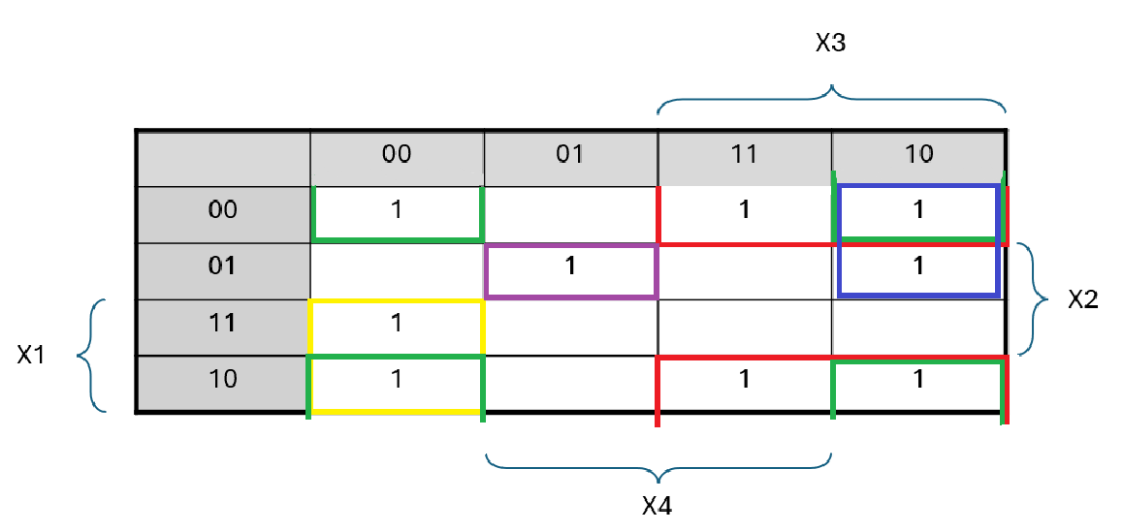
X3X4
X1X2

